Slide 1
WOMEN CONDITIONS: MEDIEVAL SOCIETY VS THIRD-WORLD COUNTRIES
By Venier Alyssa Trinity

Slide 2
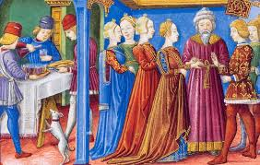
FEMALE COMMON FACTS AND CONDITIONS
The middle Ages
For most girls and women, distress, hardship, pain and suffering was a historical fact.
All female were considered inferior to man by nature and by laws and was expected to be obedient and subservient to their fathers and then to their husbands
The third-world countries
Although modern civilized countries consider women and men at the same way, many retrograde countries still refer to women as the «weak sex»; they are useful just to give birth and care children and the house. In many countries, they are treated as object, they haven’t the control of their own life. Female are subservient to the men of the family.

Slide 3
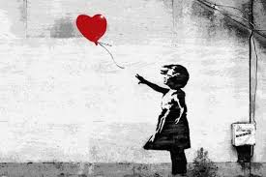
MARRIAGE AND CHILD BRIDES
The Middle Ages
Women were often married by age 14 and had their first baby by age 15.
The most common death in young woman was give birth, this is because of the crude medical knowledge and care.
The third-world countries
The reality of child brides is still common. They’re parents usually organize marriage to improve their economical situation, but it might also be a cultural phenomenon.
In India, the half part of the girls get married before they reach 18 years old, and some of them are under 10 years.
Many of them often dead giving birth because of the terrible sanitary conditions and the very young age.

Slide 4
CONDITION OF WOMEN DUE TO THEIR WALK OF LIFE
Women conditions changed on the basis of where they lived and their family situation, in fact, the life of poor women were completely different from the noble’s.

Slide 5
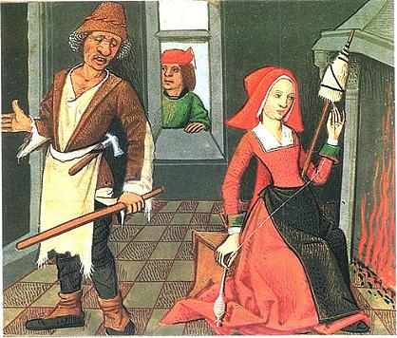
PAESANTS WOMEN
THEIR LIFE
The peasant woman, as Piers Plowman described them, worked in the fields alongside their husbands, moreover they had to care for their children, keep house, cook and make clothes for her family.
Spinning sheep’s wool into thread and yarn was so common that the tool used, a spindle or a distaff became a symbol of the peasants women.

Slide 6
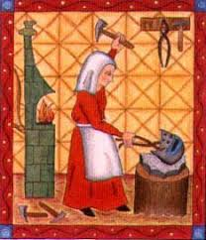
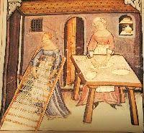
WOMEN IN TOWNS
These women had a better chance of learning a trade and they were often employed in shops and bakeries or as weavers and spinners, but there were also women merchants, druggists, barbers and brewers. All this was in addition to the role of primary carer for the family.
They were generally banned from joining the powerful professional union guild or charging as much as man

Slide 7
NOBLE & WEALTHY WOMEN
The middle Ages
Noble women had more access to education and servants which allowed them to became artist, musicians and writers. They were also skilled in the art of embroidery and dance.
The third world countries
Girls from a wealthy family have more possibilities to attend a secondary school and understand their rights and fight for them, further more, if the parents of the girls studied, they could understood the importance of receiving a school education and the rights of women and they don’t want to «sell» their daughters.
Sadly, in some countries, the problem is bigger than poverty, it involves religion, culture and ignorance: in some states girls cannot study because of dictatorship and totalitarian governments, which forbidden girls education, and that’s worse than medieval society, where education was a money matter.

Slide 8
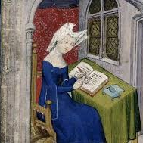
Christine de Pizan
She was a Frenchwoman considered a pioneering feminist, in fact she wrote about the virtue and value of women.
«I feel most unfortunate because God had made me inhabit a female body in this world» Christine de Pizan

Slide 9
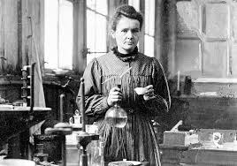
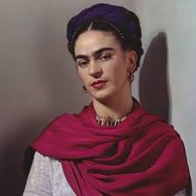
EXAMPLES OF GREAT FEMINIST IN THE LAST CENTURY
In many countries, feminism movements improved the inequality between sexes, however, there are countries where the conditions are still similar with Middle Ages, or worst.
There are people and organizations who still fight for the equality and try to give voices to the ones who can’t speak.
Below I wrote some inspiring women who can be considered great feminists:
Marie Curie was a great scientist, physicist and chemist. Her country didn’t give her the possibility to study and work, but she found a way, and became the first woman that received a noble prize (and she received more than one).
Frida Kahlo was a painter famous for her revolt against the canons of beauty of the woman.
Emma Watson is a famous actress and besides that, she is also Godwill ambassador of Onu for Women and voice of the movement HeForShe.

Slide 10
THE PARADOX: escape in the convent
The Middle Ages
What can an upper-class woman do if she didn’t want to be a wife and a mother? The solution came from the same organization that restricted woman in so many ways: the Roman Catholic Church.
Women who became nuns devoted themselves to study contemplation and caring for the sick. Nuns could rise to became the leaders of Abbeys and monastery, sometimes even overseeing male priests.
The Third-world countries
Even in India, some women find in monastic life the key for freedom and serenity, in spite of a life full of abuse and violence.

Slide 11
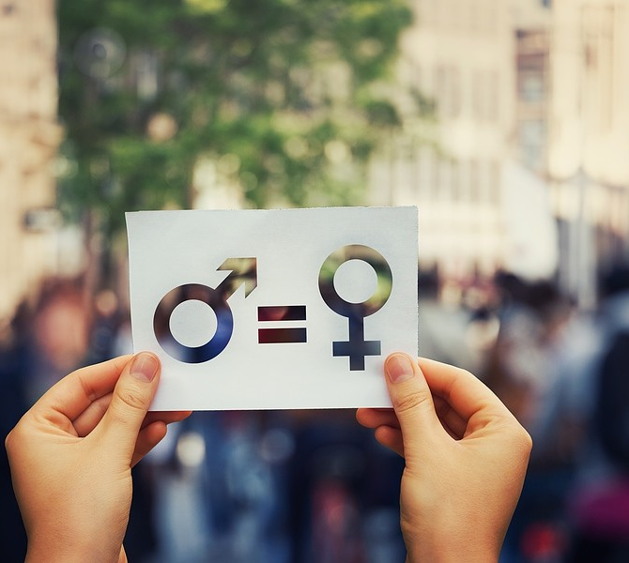
CONCLUSION
After the comparison of conditions of women between the Middle Ages and our times, we can be glad for the changes in our civilization countries, but we can easily understand that some countries haven’t changed from the ancient times, so we must fight against the inequality of sexes, and even if we are still far from a completely solution, one day we’ll reach it!

Slide 12
THE FIRST CHANGES
The Middle Ages
The Third-world countries
Near the end of the Middle Ages things began to change in favour of women in some of the most developed city states such as Florence.
However they had to wait centuries before they would win their first rights and freedoms that hundreds of women have today.
Slowly, things started to change in many countries: there are lots of organization such as Unicef that helps people and fights for women rights and they have been successful in lots of them. Onlus AFLIN is an organization that concretely helps Indian girls, first of all providing their school education.

