Slide 1
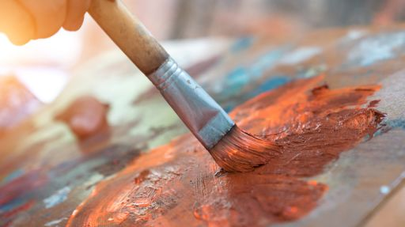
THE BENEFITS OF PAINTING
The power of an amazing art
By Alyssa Trinity Venier

Slide 2

Benefits of painting
What are you thinking about when I utter the word “painting”?
I'm pretty sure that most of you will have imagined a paintbrush, some colours and maybe a canvas or a palette…
…but what I’m going to do is try to explain you that there is something more and deeper in this beautiful art…

Slide 3
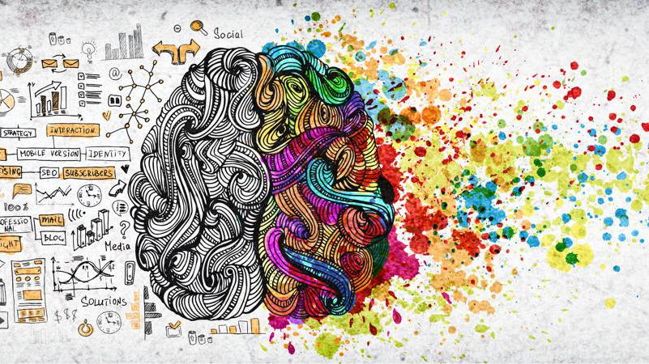
Painting develops creativity…

Slide 4

…it improves memory…

Slide 5

…it is a good antistress…
Fare clic per inserire testo

Slide 6

…it improves concentration…

Slide 7
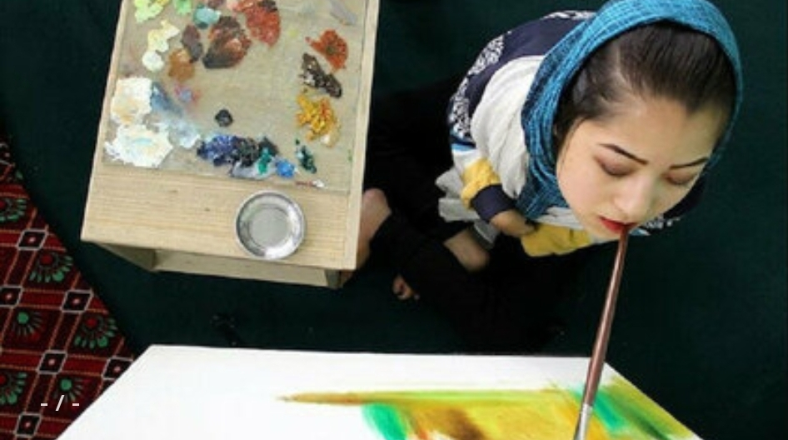
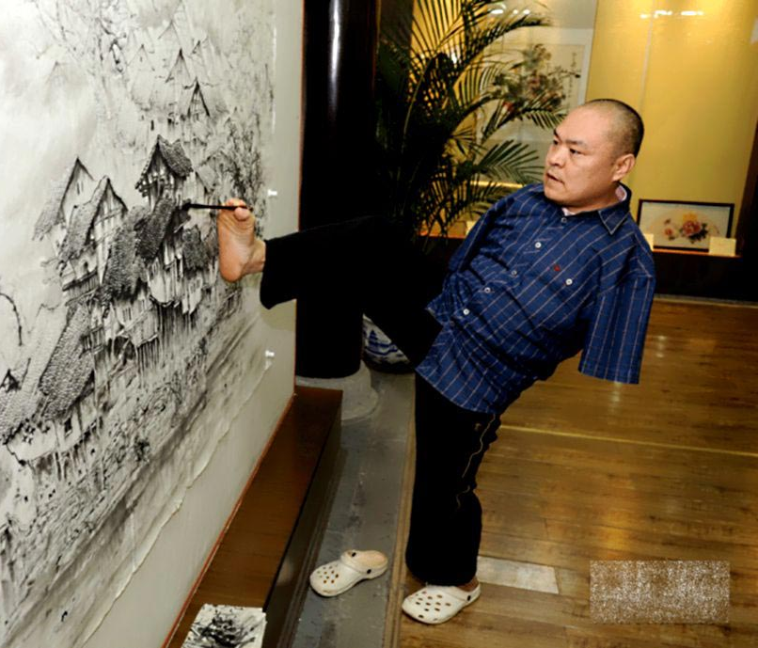
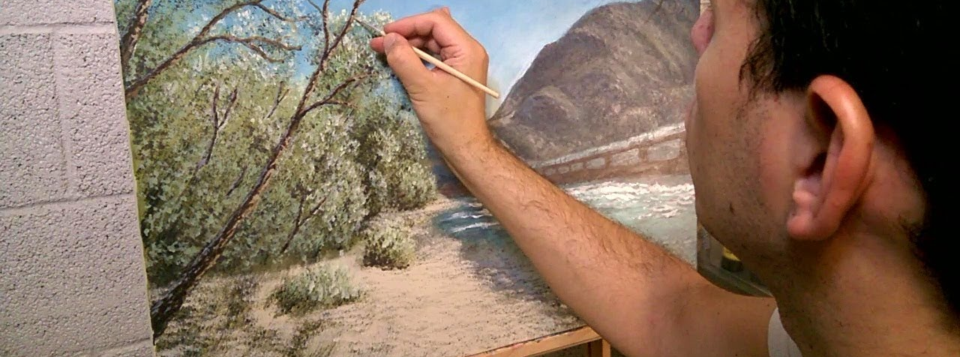
…it improves your motricity…

Slide 8
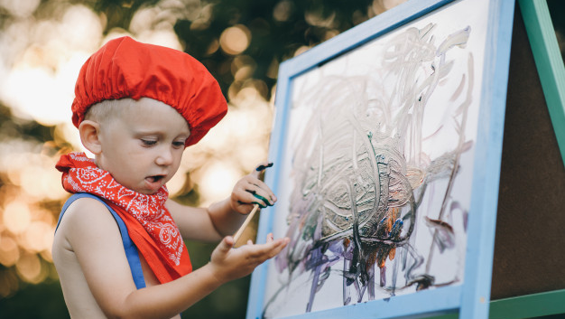
… it improves your communication skills…

Slide 9
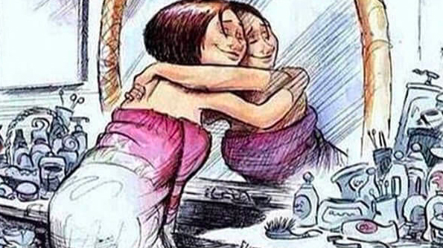
...and it strengthens your self-esteem…

Slide 10
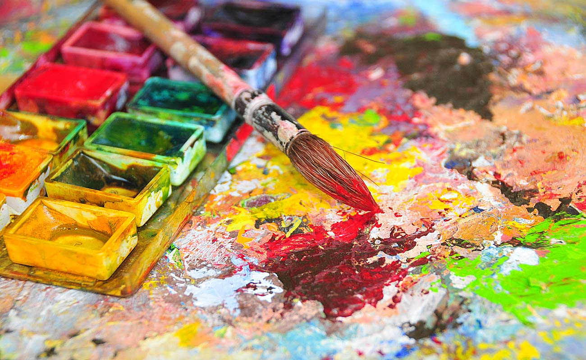
These are just a few of the many benefits of painting. I hope, at least some of you will have changed your mind about this art by the time I have finished my talk and if you want, you can try painting too!
You might discover a new passion, a new way to express yourself and add other benefits to this list!

Slide 11
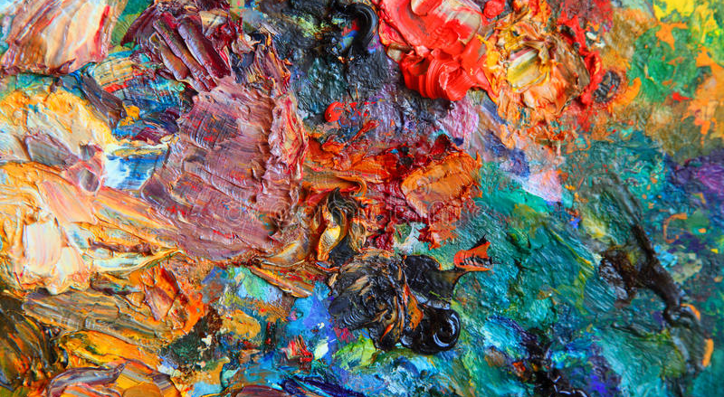
"If the paintings could be explained and translated into words, there would be no need to paint them."
- Courbet-

