Slide 1
THE MIDDLE AGES
By Alyssa Trinity Venier

Slide 2
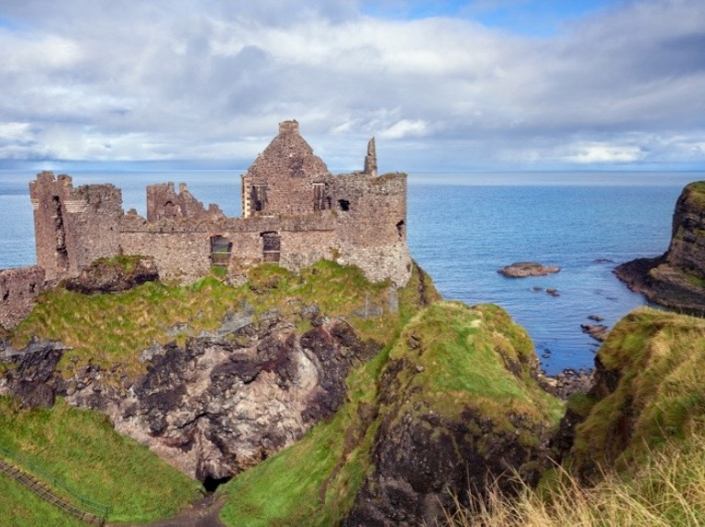
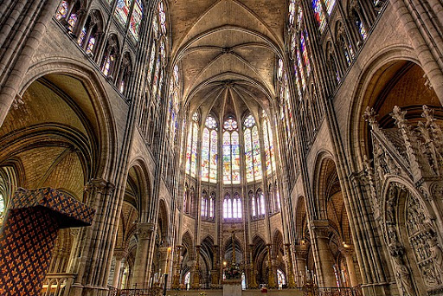
THE PAST IN THE PRESENT
Castles:
Castle building was common in Britain after the invasion and conquest by the Normans in 1066.The Clifford’s Tower is one of the earliest buildings constructed in the High Middle Ages still standing today.
Gothic Architecture:
The gothic architecture flourished in the high and late medieval periods. The Gothic style is characterized using ‘flying buttresses’ and pointed arches, techniques which allowed interiors to be higher, lighter and more airy and ornate spaces.

Slide 3
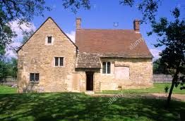
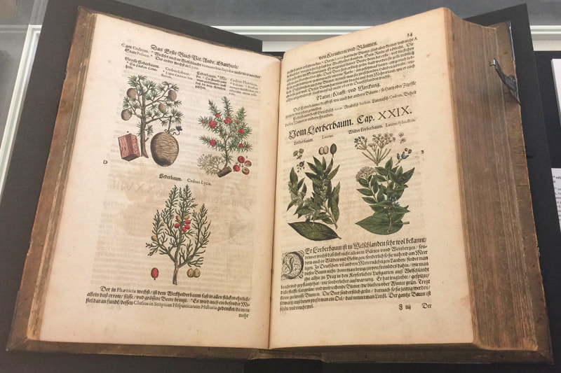
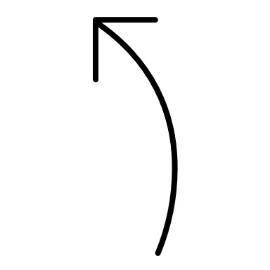
THE PAST IN THE PRESENT
The Lord of the Manor
Medieval manor houses were owned by the wealthy. The village layout of medieval times can still be seen in the centre of many rural English villages
Herbalism
An important form of medicine in the Middle Ages was Herbalism, whose curative powers are still valued today.

Slide 4
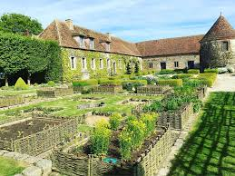
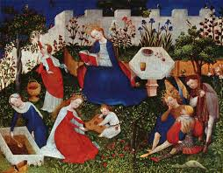
THE PAST IN THE PRESENT
Medieval Gardens
The garden of a castle, manor or monastery, tended to be highly functional and herb gardens and vegetables gardens provided food and medicinal products.
Gardens were laid out in rectangular plots, with narrow paths between them.
Other parts of the garden were dedicated to pleasure and relaxation.
Favourite vegetables: fennel, cabbage, onion, garlic, leeks, radishes, parsnips, peas, lentils and beans,
herbs: savory, costmary, fenugreek, rosemary, peppermint, rue, iris, sage, bergamot, mint, lovage, fennel and cumin

Slide 5


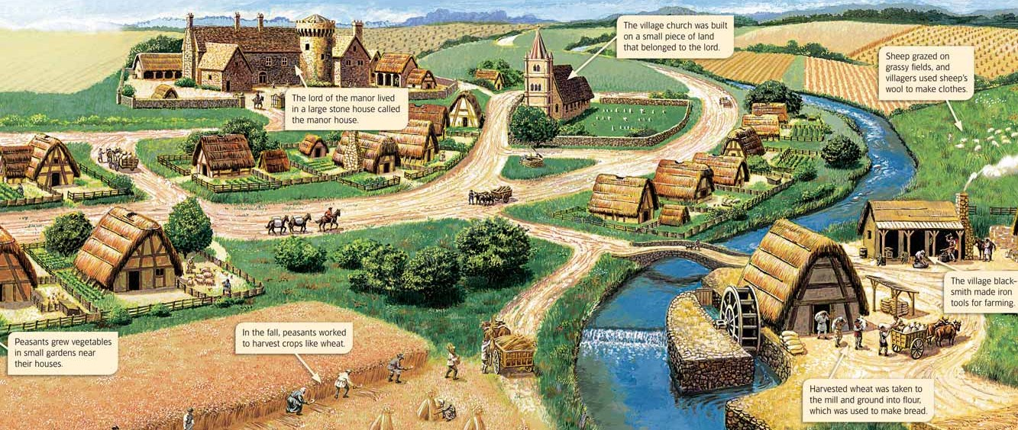
THE PAST IN THE PRESENT
An English Manor
A rural village under the feudal system

Slide 6
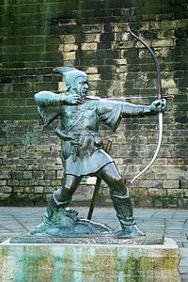
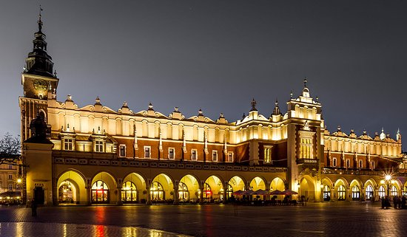
THE PAST IN THE PRESENT
“Laken” is the Flemish word for a type of high quality woolen woven cloth.
Medieval Legend
Legendary figures like Robin Hood date back to medieval times. Robin Hood is said to have lived in Sherwood Forest near Nottingham in the 13th century and he is still popular today because of his views on the redistribution of wealth.
Cloth and Wool Trade
The Cloth Hall, called the Lakenhalle in Flemish, is located in the centre of Ypres. During medieval times the Cloth Hall was the commercial heart of the city in its role as the place where the trading of cloth and wool was carried out. In medieval England, wool was an important product for export, the driving force of the medieval economy.
Medieval Legend

Slide 7
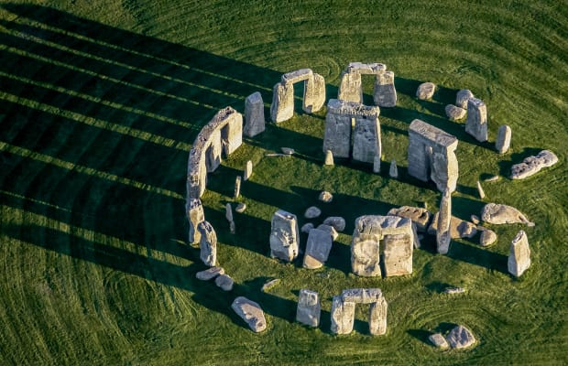
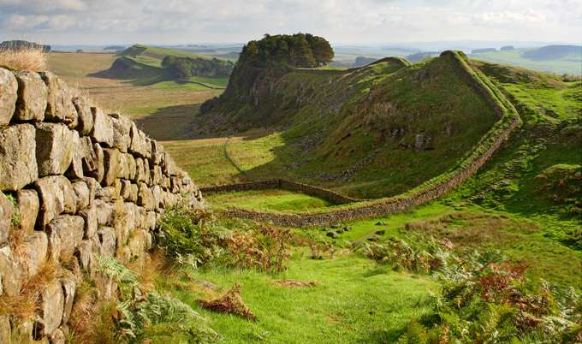
ANCIENT TIMES
Stonehenge
From about 3.800 to 2.500 BC early inhabitants including settlers from Iberia built causeways, earthworks and megalithic monuments, such as Stonehenge and the village of Skar Brae in Scotland
Hadrian’s Wall
The first roman invasion of Britain took place in 55 BC and its conquest in 43 AD under the Emperor Claudius. Many native population made resistance. Under Agricola, the troops marked the boundary of the Roman Empire by building Hadrian’s Wall in 122 AD.

Slide 8
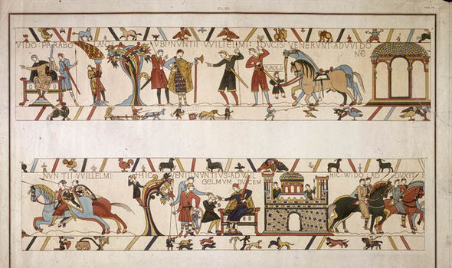
MIDDLE AGES
Sutton Hoo
Information about life in Anglo-Saxon England (449-1066) comes down to us from various sources including the archeeological site at Sutton Hoo, this was a burial ground reserved for the aristocracy of the 7th century East Anglian kingdom.
In 1939 excavator find the ship burial of the King Raedwald, who died in 625 AD, containing a rich trove which had been buried with the king to accompany him in the after-life.
The Bayeux Tapestry
It is an embroidered cloth measuring almost 70 metres by 50 centimetres.
It combinates action pictures and Latin text to show the events leading up to the Norman conquest of England in 1066 guided by William, duke of Normandy.

Slide 9
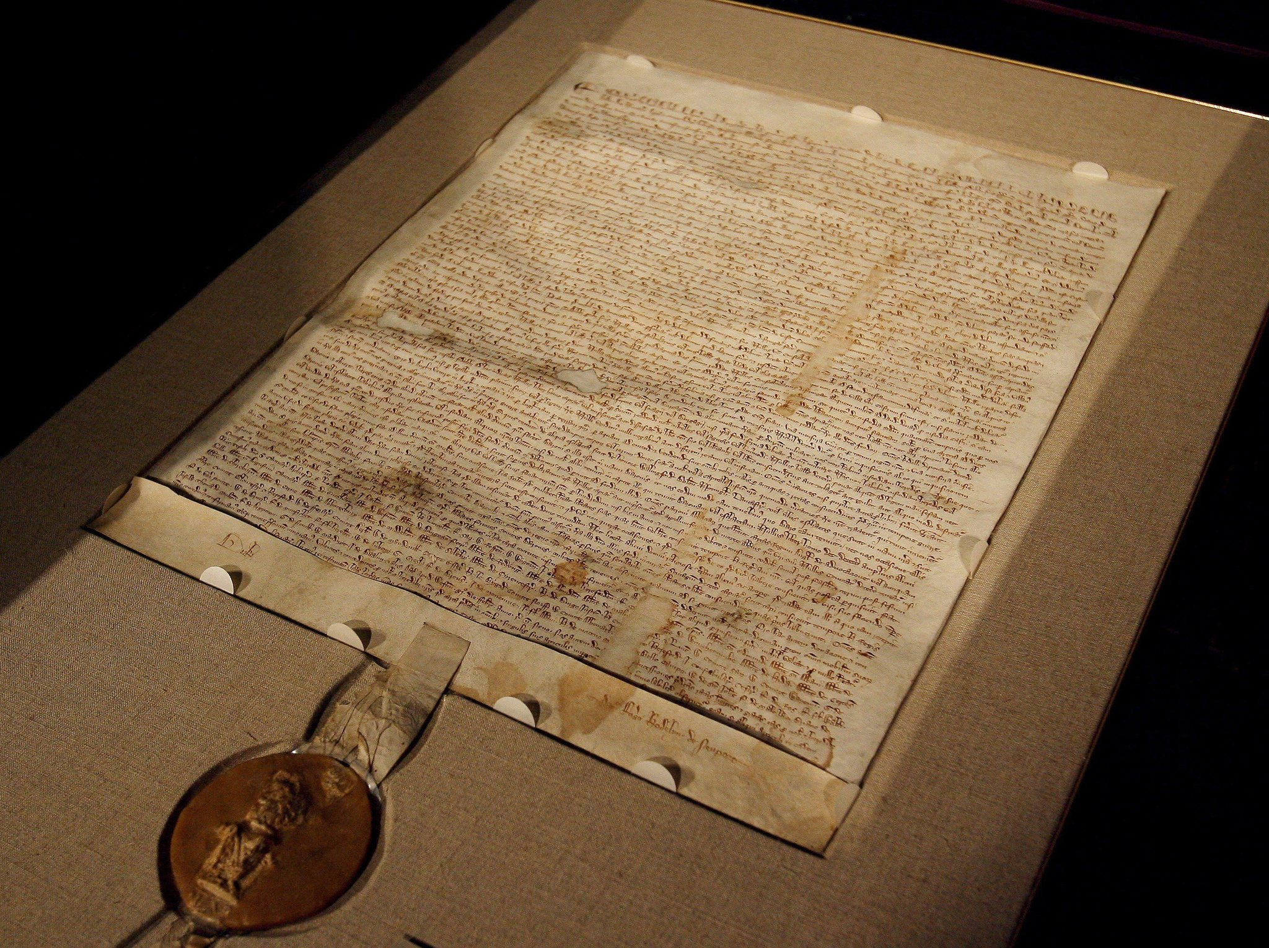
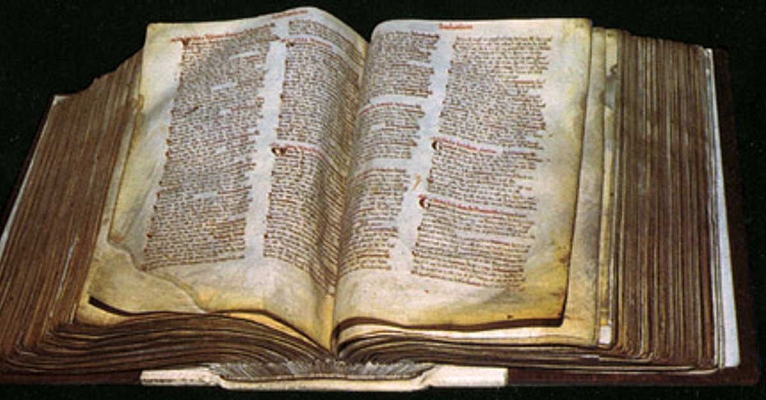
MIDDLE AGES
The Magna Carta
Signed in June 1215
By King John and the barons
For the first time in England, a nation charter limits and controls the abuse of power by a monarch and outlines the right of all people to be treated fairly and justly under the law
It is the base of modern constitution
The Domesday Book
Compiled during the reign of King William I
It gives a detailed picture of medieval life and lifestyle and is the precursor of all future population census, it was useful for calculating taxes, too.

Slide 10
THE CULTURAL CONTEXT
Early Middle Ages
476: The Fall of western Roman Empire brought about significant changes in European society and is considered as the beginning of Middle Ages
590: The Anglo-Saxon England began to take shape. England was unified by the 9° century.
1066: With the Battle of Hastings William of Normandy became the King and united England and Normandy. William divided all land into manors and established the feudal system.
1170: Murder of Thomas Becket, Archbishop of Canterbury. He opposed Henry’s reform, and for that he was assassinated.
1295: Edward I inaugurated the first representative parliament, The model parliament.

Slide 11
THE CULTURAL CONTEXT
Late Middle Ages
1315-1317: The Great Famin caused the death from hunger and disease of a large portion of the population.
1337-1453: Hundred Years’ War between France and Britain, in the end the English lost the main part of possession on the foreign country.
1346-1350: The Black Death was the most deadly epidemic of the Middle Ages in Europe. Huge number of people died and economic, political power, feudal system and the Church were weakened
1455-1485: The Wars of the Roses is a bloody civil war between the Houses of Lancaster and York for the accession to the throne. The war ended with the accession of the Tudors to the English throne.

